Slide 1
Perceptron
CSE301 Bio-computation, Week 2
Bailing Zhang

Slide 2
Outline
McCulloch-Pitts neuron
Hebb’s learning rule
Perceptron

Slide 3
Perceptron (1958)
Rosenblatt (1958) explicitly considered the problem of pattern recognition, where a “teacher” is essential.
Perceptrons are neural networks that change with “experience” using error-correcting rule.
According to the rule, weight of a response unit changes when it makes erroneous response to stimuli presented to the network.

Slide 4
What is Pattern Recogntion?
Training data: set of sample pairs (x, y).
Network (model, classifier) adjusts its connection weights according to the errors between target and network output
target
(teacher)
y(n)
Expected output
Real output
comparison
environment
input
Neural network
o(n)
x(n)
Error signal
e(n)
Supervised learning is mainly applied in classification/prediction.

Slide 5








Examples (1) signature identification
Segmentation &
Pre-processing
training data
classifier
training
new
signature
true signature
or forgery?
classifier

Slide 6






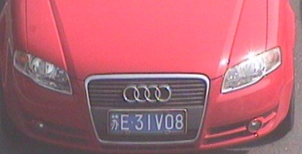
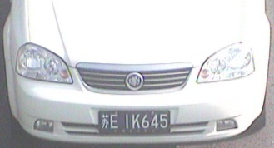

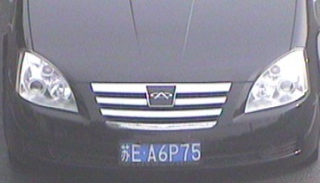
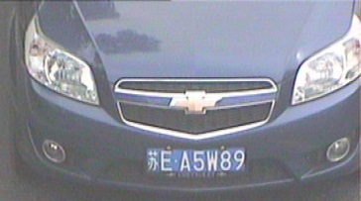
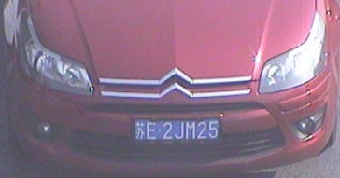
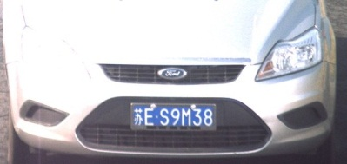
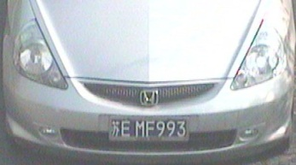
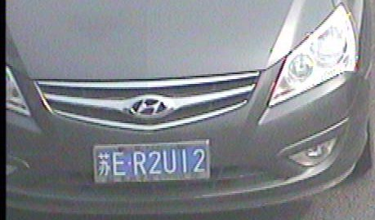
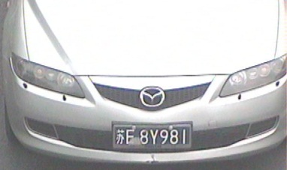
Classification Examples Examples from Intelligent Transportation
Traffic sign recognition
Vehicle recognition

Slide 7
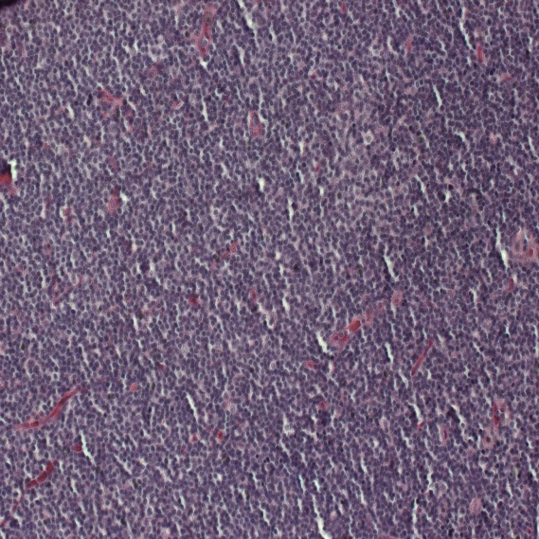
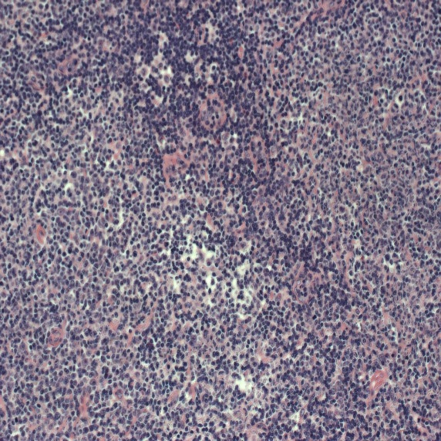
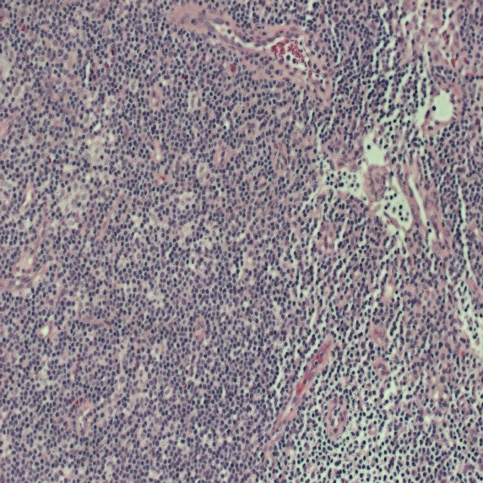
Classification Examples
Lymphoma classification
•Malignant lymphoma is a cancer affecting lymph nodes.
•Three types of malignant lymphoma are represented in the set:
CLL
FL
MCL
(chronic lymphocytic leukaemia)
(follicular lymphoma)
(mantle cell lymphoma).

Slide 8
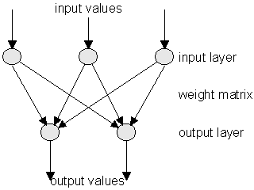
Perceptron (1958)
The simplest architecture of perceptron comprises two layers of idealised “neurons”, which we shall call “units” of the network.
Input values
input layer
adjustable layer
output layer
There are
one layer of input units, and
one layer of output units.
in the perceptron
output values

Slide 9
Perceptron (1958)
Input values
input layer
adjustable layer
output layer
output values
The two layers are fully interconnected, i.e., every input unit is connected to every output unit.
Thus, processing elements of the perceptron are the abstract neurons considered earlier.
Each processing element has the same input comprising total input layer, but individual outputs with individual connections and therefore different weights of connections.

Slide 10
Perceptron (1958)
Input values
The total input to the output unit j is
input layer
adjustable layer
output layer
output values
: input value from the ith input unit
: the weight of connection btw i-th input and j-th output units
The sum is taken over all n+1 inputs units connected to the
output unit j.
There is special bias input unit number 0 in the input layer.

Slide 11
Perceptron (1958)
Input values
input layer
adjustable layer
output layer
output values
• There is a special bias input unit number 0 in the input layer.
• The bias unit always produces inputs of the fixed values of +1.
• The input of bias unit functions as a constant value in the sum.
• The bias unit connection to output unit j has a weight
adjusted in the same way as all the other weights

Slide 12
Perceptron (1958)
The output value of the output unit j depends on whether the weighted sum is above or below the unit's threshold value.
is defined by the unit's threshold activation function.
Definition:
the ordered set of instant outputs of all units in the output
layer
constitutes an output vector of the network

Slide 13
Perceptron (1958)
The instant output of the j-th unit in the output layer constitutes the j-th component of the output vector.
Weight w_{ji} of connections between the two layers are changed according to perceptron learning rule, so the network is more likely to produce the desired output in response to certain inputs.
The process of weights adjustment is called perceptron “learning” or “training”.

Slide 14
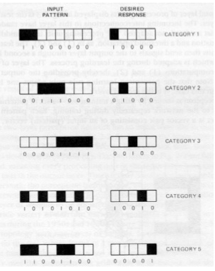
Perceptron Training Example
Input pattern
Desired response
The perceptron is trained by using a training set –
A set of input patterns repeatedly presented to the network during training, and corresponding desired responses, i.e., the target outputs.
Shown is an example training set with binary vector patterns.
The target outputs are shown along with each of the training input patterns.
category 1
category 2
category 3
category 4
category 5

Slide 15
Perceptron Training
Input pattern
Desired response
Input values
category 1
input layer
category 2
adjustable layer
category 3
output layer
output values
category 4
Every input pattern of the set is
repeatedly presented to the
perceptron.
category 5

Slide 16
Perceptron Training
Every processing element computes an output according its state and threshold:
The network instant outputs
X_{j} are then compared to the
desired outputs specified
in the training set.
The error of an output unit is the difference between the target output and the instant one.

Slide 17
Perceptron Training
1. The error are computed, and
2. used to readjust the values of the
weights of connections.
The weights re-adjusment is done in such a way that the
network is – on the whole – more likely to give the desired
response next time.

Slide 18
Perceptron Updating of the Weights
The goal of the training session is to arrive at a single set of weights that allow each of the mappings in the training set to be done successfully by the network.
1. Compute “error” of every output unit
where
is the target value for output unit j after presentation of pattern p
is the instant output produced by output unit j after presentation of pattern p

Slide 19
Perceptron Updating of the Weights
Having the errors computed,
2. Update the weights
new
old
Perceptron learning rule
where

Slide 20
Example
Define our “features”:
For output:
Good_Fruit = 1
Not_Good_Fruit = 0
Taste | Sweet = 1, Not_Sweet = 0
Seeds | Edible = 1, Not_Edible = 0
Skin | Edible = 1, Not_Edible = 0
Notes:
20

Slide 21
Example
Let’s start with no knowledge:
Input
Taste
0.0
Output
0.0
Seeds
0.0
If ∑ > 0.4
then fire
Skin
Notes:
21

Slide 22
Example
To train the perceptron, we will show it each example and have it categorize each one.
Since it’s starting with no knowledge, it is going to make mistakes. When it makes a mistake, we are going to adjust the weights to make that mistake less likely in the future.
Notes:
22

Slide 23
Example
When we adjust the weights, we’re going to take relatively small steps to be sure we don’t over-correct and create new problems.
We’re going to learn the category “good fruit” defined as anything that is sweet.
Good fruit = 1
Not good fruit = 0
Notes:
23

Slide 24
Example
Show it a banana:
Input
1
1
Taste
0.0
Output
1
0.0
0.0
Seeds
1
0
0.0
If ∑ > 0.4
then fire
0
0
Skin
Notes:
24

Slide 25
Example
In this case we have:
(1 X 0) = 0
+ (1 X 0) = 0
+ (0 X 0) = 0
It adds up to 0.0.
Since that is less than the threshold (0.40), we responded “no.”
Is that correct? No.
Notes:
25

Slide 26
Example
Since we got it wrong, we know we need to change the weights. We’ll do that using the delta rule (delta for change).
∆w
= learning rate x (teacher - output) x input
Notes:
26

Slide 27
Example
The three parts of that are:
Learning rate: We set that ourselves. I want it to be large enough that learning happens in a reasonable amount of time, but small enough that I don’t go too fast. So pick 0.25.
(teacher - output): The teacher knows the correct answer (e.g., that a banana should be a good fruit). In this case, the teacher says 1, the output is 0, so (1 - 0) = 1.
Input: That’s what came out of the node whose weight we’re adjusting. For the first node, 1.
Notes:
27

Slide 28
Example
To pull it together:
Learning rate: 0.25.
(teacher - output): 1.
input: 1.
∆w = 0.25 X 1 X 1 = 0.25.
Since it’s a ∆w, it’s telling us how much to change the first weight. In this case, we’re adding 0.25 to it.
Notes:
28

Slide 29
Example
Let’s think about the delta rule:
(teacher - output)
If we get the categorization right, (teacher - output) will be zero (the right answer minus itself).
In other words, if we get it right, we won’t change any of the weights. As far as we know we have a good solution, why would we change it?
Notes:
29

Slide 30
Example
Let’s think about the delta rule:
(teacher - output)
If we get the categorization wrong, (teacher - output) will either be -1 or +1.
If we said “yes” when the answer was “no,” we’re too high on the weights and we will get a (teacher - output) of -1 which will result in reducing the weights.
If we said “no” when the answer was “yes,” we’re too low on the weights and this will cause them to be increased.
Notes:
30

Slide 31
Example
Let’s think about the delta rule:
Input:
If the node whose weight we’re adjusting sent in a 0, then it didn’t participate in making the decision. In that case, it shouldn’t be adjusted. Multiplying by zero will make that happen.
If the node whose weight we’re adjusting sent in a 1, then it did participate and we should change the weight (up or down as needed).
Notes:
31

Slide 32
Example
How do we change the weights for banana?
Feature: | Learning rate: | (teacher - output): | Input: | ∆w
taste | 0.25 | 1 | 1 | +0.25
seeds | 0.25 | 1 | 1 | +0.25
skin | 0.25 | 1 | 0 | 0
Notes:
32

Slide 33
Example
Here it is with the adjusted weights:
Input
Taste
0.25
Output
0.25
Seeds
0.0
If ∑ > 0.4
then fire
Skin
Notes:
33

Slide 34
Example
To continue training, we show it the next example, adjust the weights…
We will keep cycling through the examples until we go all the way through one time without making any changes to the weights. At that point, the concept is learned.
Notes:
34

Slide 35
Example
Show it a pear:
Input
1
1
Taste
0.25
Output
0
0.25
0.25
Seeds
0
0
0.0
If ∑ > 0.4
then fire
Skin
1
1
Notes:
35

Slide 36
Example
How do we change the weights for pear?
Feature: | Learning rate: | (teacher - output): | Input: | ∆w
taste | 0.25 | 1 | 1 | +0.25
seeds | 0.25 | 1 | 0 | 0
skin | 0.25 | 1 | 1 | +0.25
Notes:
36

Slide 37
Example
Here it is with the adjusted weights:
Input
Taste
0.50
Output
0.25
Seeds
0.25
If ∑ > 0.4
then fire
Skin
Notes:
37

Slide 38
Example
Show it a lemon:
Input
0
0
Taste
0.50
Output
0
0.25
0
Seeds
0
0
0.25
If ∑ > 0.4
then fire
0
0
Skin
Notes:
38

Slide 39
Example
How do we change the weights for lemon?
Feature: | Learning rate: | (teacher - output): | Input: | ∆w
taste | 0.25 | 0 | 0 | 0
seeds | 0.25 | 0 | 0 | 0
skin | 0.25 | 0 | 0 | 0
Notes:
39

Slide 40
Example
Here it is with the adjusted weights:
Input
Taste
0.50
Output
0.25
Seeds
0.25
If ∑ > 0.4
then fire
Skin
Notes:
40

Slide 41
Example
Input
1
1
Taste
0.50
Output
1
0.25
1
Seeds
1
1
0.25
If ∑ > 0.4
then fire
1
1
Skin
Show it a strawberry:
Notes:
41

Slide 42
Example
How do we change the weights for strawberry?
Feature: | Learning rate: | (teacher - output): | Input: | ∆w
taste | 0.25 | 0 | 1 | 0
seeds | 0.25 | 0 | 1 | 0
skin | 0.25 | 0 | 1 | 0
Notes:
42

Slide 43
Example
Here it is with the adjusted weights:
Input
Taste
0.50
Output
0.25
Seeds
0.25
If ∑ > 0.4
then fire
Skin
Notes:
43

Slide 44
Example
Show it a green apple:
Input
0
0
Taste
0.50
Output
0
0.25
0.25
Seeds
0
0
0.25
If ∑ > 0.4
then fire
1
1
Skin
Notes:
44

